Slide 1
INVESTIGATION OF INERTIAL SUPPORT LIMITS IN WIND TURBINES AND THE EFFECTS ON THE POWER SYSTEM STABILITY
Erencan DUYMAZ
Supervisor: Assist. Prof. Dr. Ozan KEYSAN
Thesis Defence
For
The Degree of Master of Science
in Electrical and Electronics Engineering
Friday, January 18th, 2019

Slide 2
Agenda
Renewable Energy Status and Problems
Inertia, Frequency and Inertial Support Concepts
Wind Turbine Modelling
Fast Inertial Support
Synthetic Inertia Support
Effects on the Turkish Electricity Network
Economical Perspective
Conclusion

Slide 3
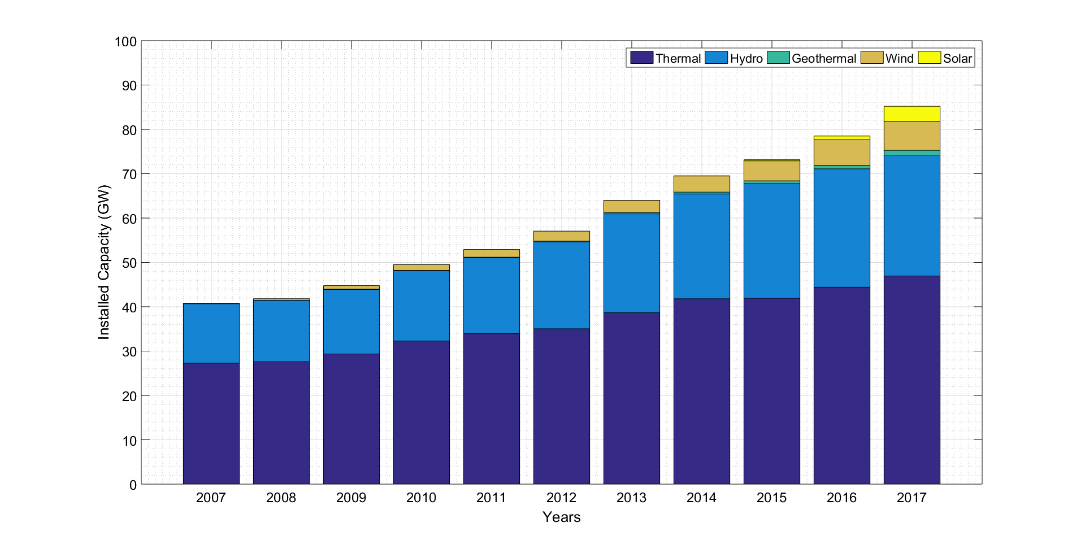
Renewable Energy Problems
Figure 1: Variation of the Installed Capacity of Turkey based on Primary Energy Source [1]

Slide 4
Renewable Energy Problems
Benefits:
Reduction in fossil fuel usage
Reduction in CO₂ emission
Challenges:
Operational problems due to intermittent nature of renewable sources
Reduction in grid inertia due to existing control structure of units with power electronics

Slide 5
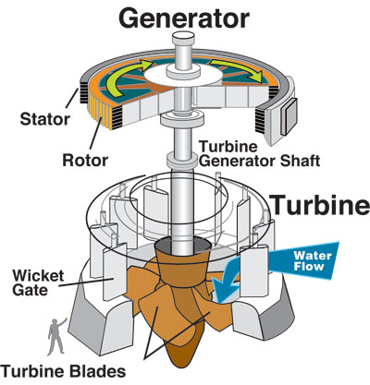
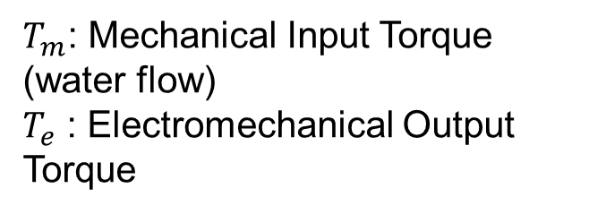

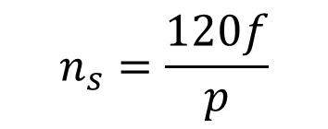
Synchronous Generator
$$n_{s}=\frac{120f}{p}$$
$$T_{m}−T_{e}=J\frac{dω}{dt}$$
$T_{m}$: Mechanical Input Torque (water flow)
$T_{e}$ : Electromechanical Output Torque
Figure 2: Turbine and Generator of a Hydro Power Plant
Notes:
Synchronous generators produces torque only in synchronous speed.
When they are sycnhronized to grid frequency, Tm=Te
Rotor of the synchronous generator is strictly coupled to stator rotating MMF.

Slide 6
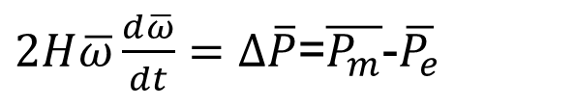


Swing Equation
$$T_{m}−T_{e}=J\frac{dω}{dt}$$
$$H=\frac{\frac{1}{2}Jω^{2}}{S_{base}}$$
$2H\overline{ω}\frac{d\overline{ω}}{dt}=Δ\overline{P}$=$\overline{P_{m}}$-$\overline{P_{e}}$
Figure 3: Turbine and Generator of a Hydro Power Plant
Notes:
Swing Equation is important for power system frequency stability and investigates the relation between speed and the power. As the frequency decreases, generator slows down and this creates an increase in the active power output.

Slide 7
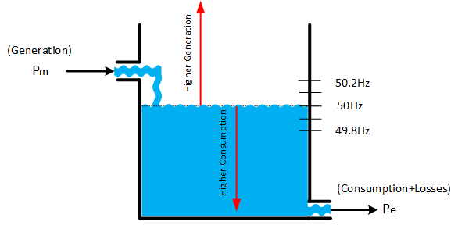
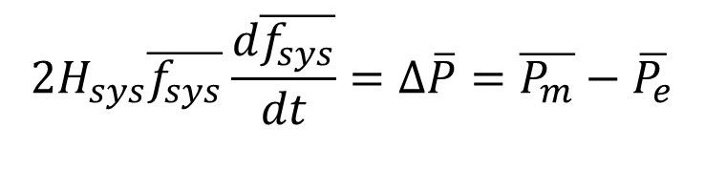
Frequency
Frequency Regulating Mechanisms in Grid:
Primary Frequency Control (no longer than 15s)
Secondary Control
Tertiary Frequency Control
$$2H_{sys}\overline{f_{sys}}\frac{d\overline{f_{sys}}}{dt}=Δ\overline{P}=\overline{P_{m}}−\overline{P_{e}}$$
Figure 4: Frequency behaviour in electric grid with the water level in a container analogy [2]
Notes:
When all generators in the grid is considered as a single generator,

Slide 8
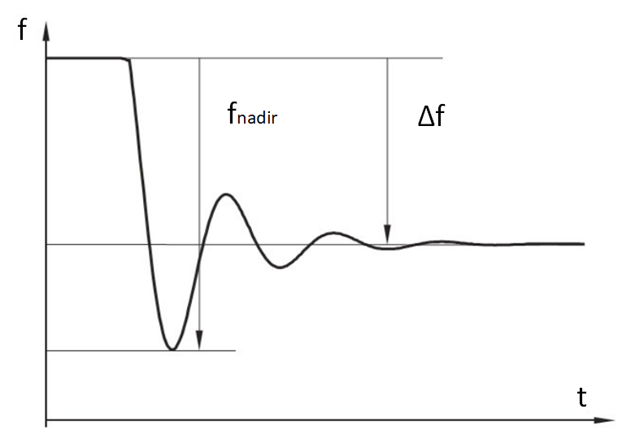
Frequeny Disturbance
Inertial Support decreases the RoCOF
Until the primary controller action, the frequency falls.
Frequency decline is arrested by Inertial Support and Primary Frequency Controllers
Higher Grid Inertia
Lower RoCoF
Figure 5: Typical Frequency Disturbance

Slide 9
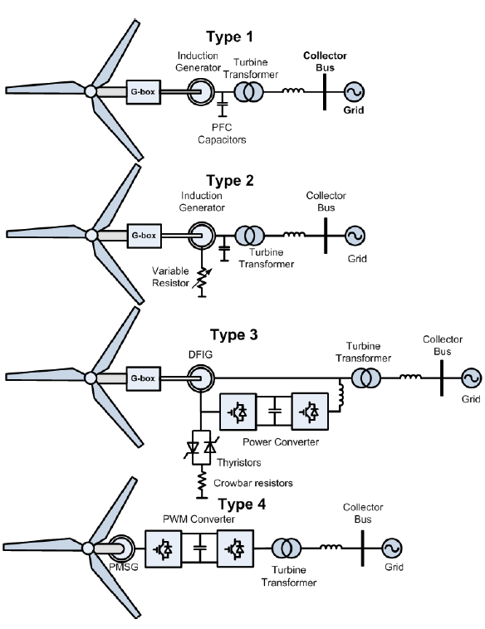
Renewable Energy Problems
Frequency changes create small deviations in Type-1 and Type-2 turbines.
Frequency changes do not affect Type-3 and Type-4 turbines.
Existing structure decreases grid effective inertia!
Figure 6: Wind Turbine Generator Configurations [3]
Notes:
Case is quite different in renewable energy systems. First of all, the renewable system might not include inertia as in the case of PV. Therefore, no inertial contribution is not provided to grid. Even though significant amount of inertia exists in the wind turbines, the inertia is generally not reflected to grid side. In the right hand side,

Slide 10
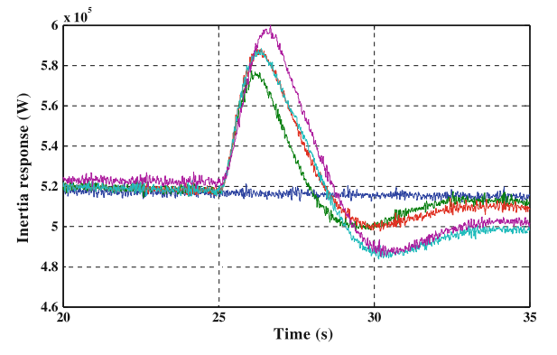
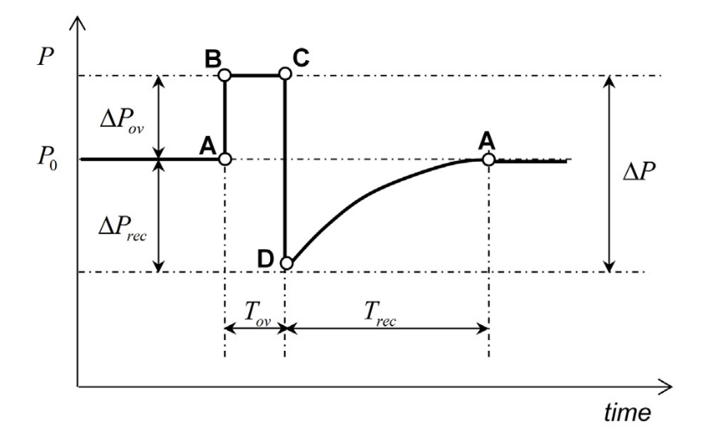
Renewable Energy Problems
The decrease in the grid inertia can be solved by emulating inertia support in the renewable energy systems.
Wind turbines with FSPC are the most promising type of renewable energy system due to its kinetic energy in the turbine inertia and the ability to control active/reactive power.
Figure 7: Synthetic Inertia vs Fast Inertial Support [4], [5]

Slide 11
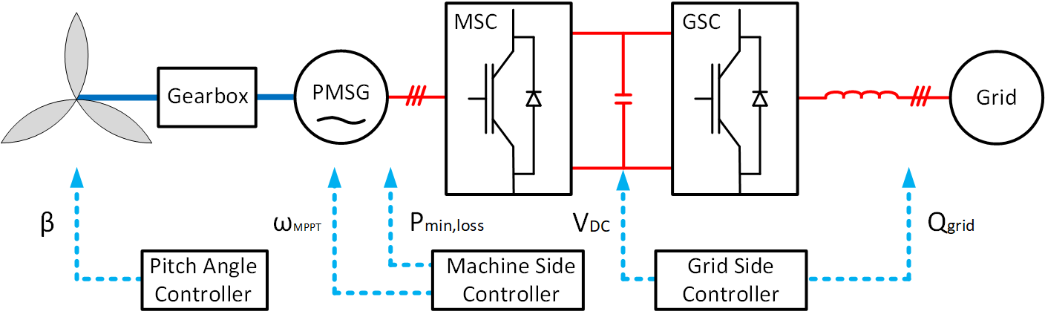
Wind Turbine Modelling
Figure 8: Geared PMSG Wind Turbine Modelling
Notes:
Figure shows the modelling for the PMSG wind turbine that is connected to grid with FSPC. There are two converters in this type of the converter with different responsibilities. The one connected between DC-bus and grid is called Grid Side Converter and it is responsible for maintaining a constant DC-bus voltage and adjusting the reactive power that is injected to grid. The converter in between DC bus and PMSG is called Machine Side Controller. It is adjusts the generator and turbine speed to MPPT speed by controlling its output torque. When the output torque hits the limit, the speed cannot be regulated and exceeds the maximum allowable speeds. This is why Pitch angle controller is utilized. By increasing the pitch angle of the turbine, the aerodynamic power and aerodynamic torque is decreased. In this way, turbine speed is kept in the maximum in high speeds.

Slide 12
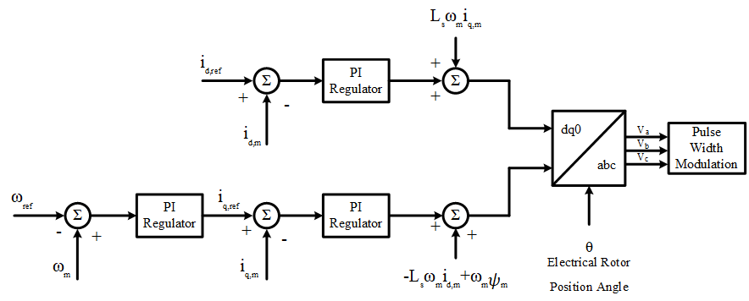
Wind Turbine Modelling
Figure 9: Existing Machine Side Controller Diagram

Slide 13
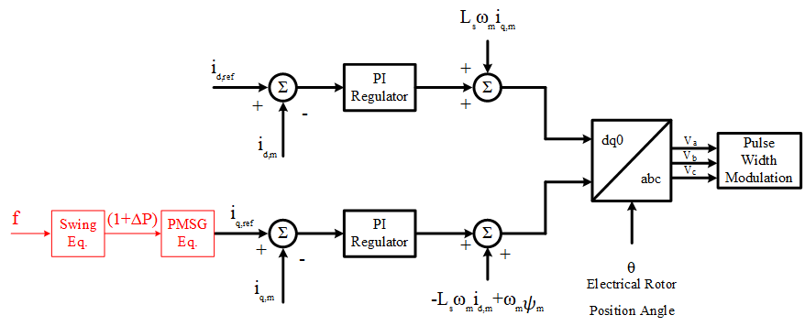
Wind Turbine Modelling
Figure 10: Modification of Machine Side Controller Diagram for Synthetic Inertia Method
Notes:
In order to provide a inertial support, the wind turbine active power should be controlled. Therefore, the MPPT speed operation is leaved. The turbine torque is adjusted by controlling the q-axis current. The active power increase is either a defined percentage as in the case of fast inertial support or the active power increase according to Swing Equation.

Slide 14
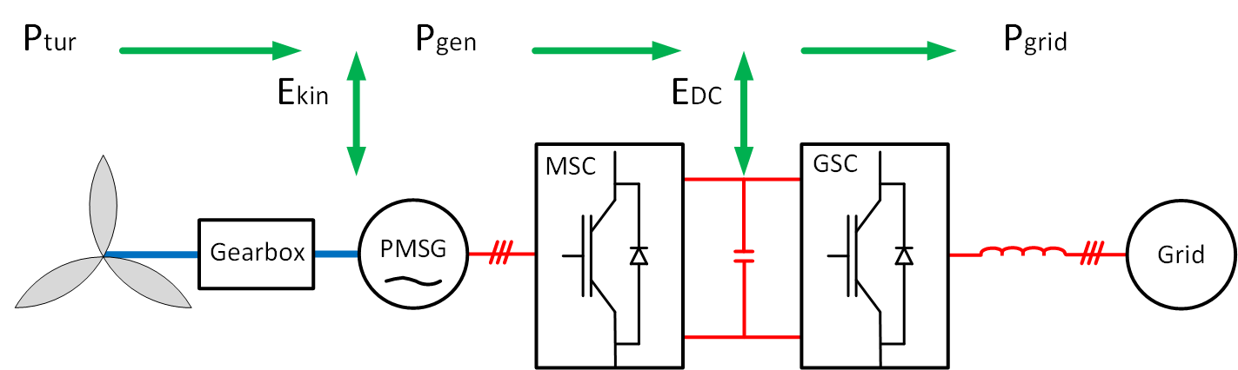
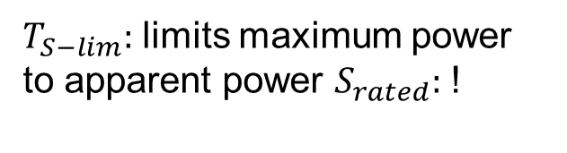
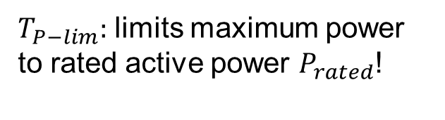
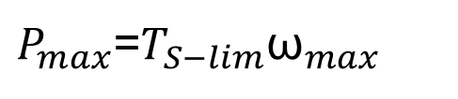
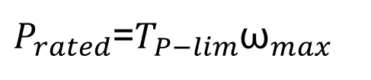
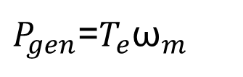
Fast Inertial Support
Figure 11: Power Flow inside the Wind Turbine
$T_{P−lim}:$ limits maximum power to rated active power $P_{rated}$!
$P_{gen}$=$T_{e}{\text{ω}}_{m}$
$P_{rated}$=$T_{P−lim}{\text{ω}}_{max}$
$T_{S−lim}:$ limits maximum power to apparent power $S_{rated}:$ !
$P_{max}$=$T_{S−lim}{\text{ω}}_{max}$

Slide 15
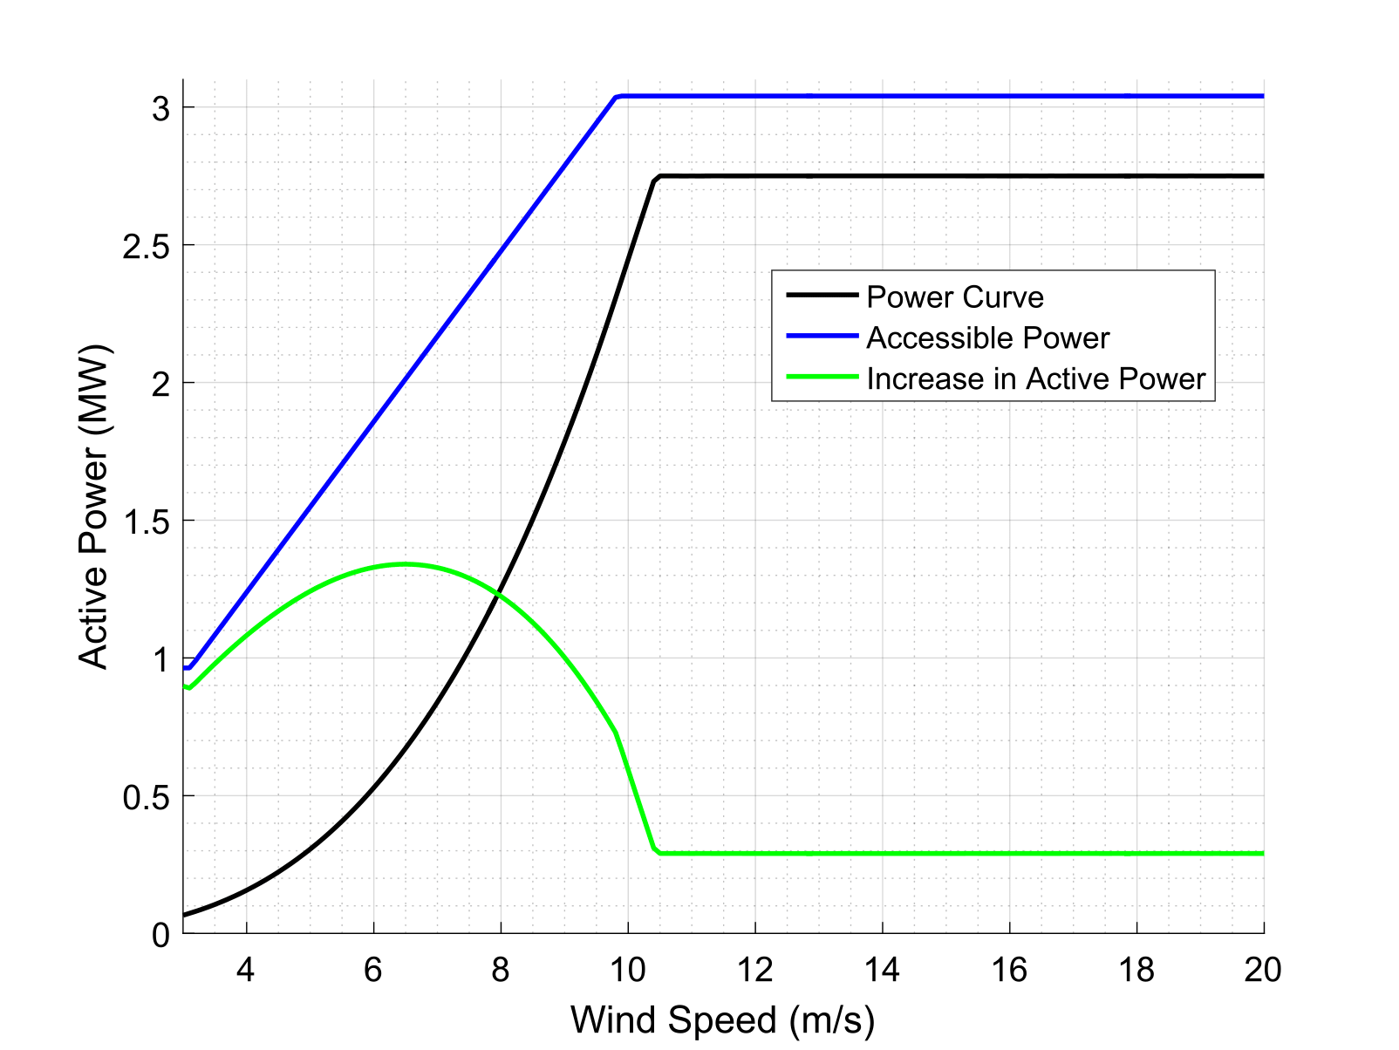
Fast Inertial Support
Figure 12: Incresed Active Power for Varying Wind Speed
Notes:
Converter Limit

Slide 16
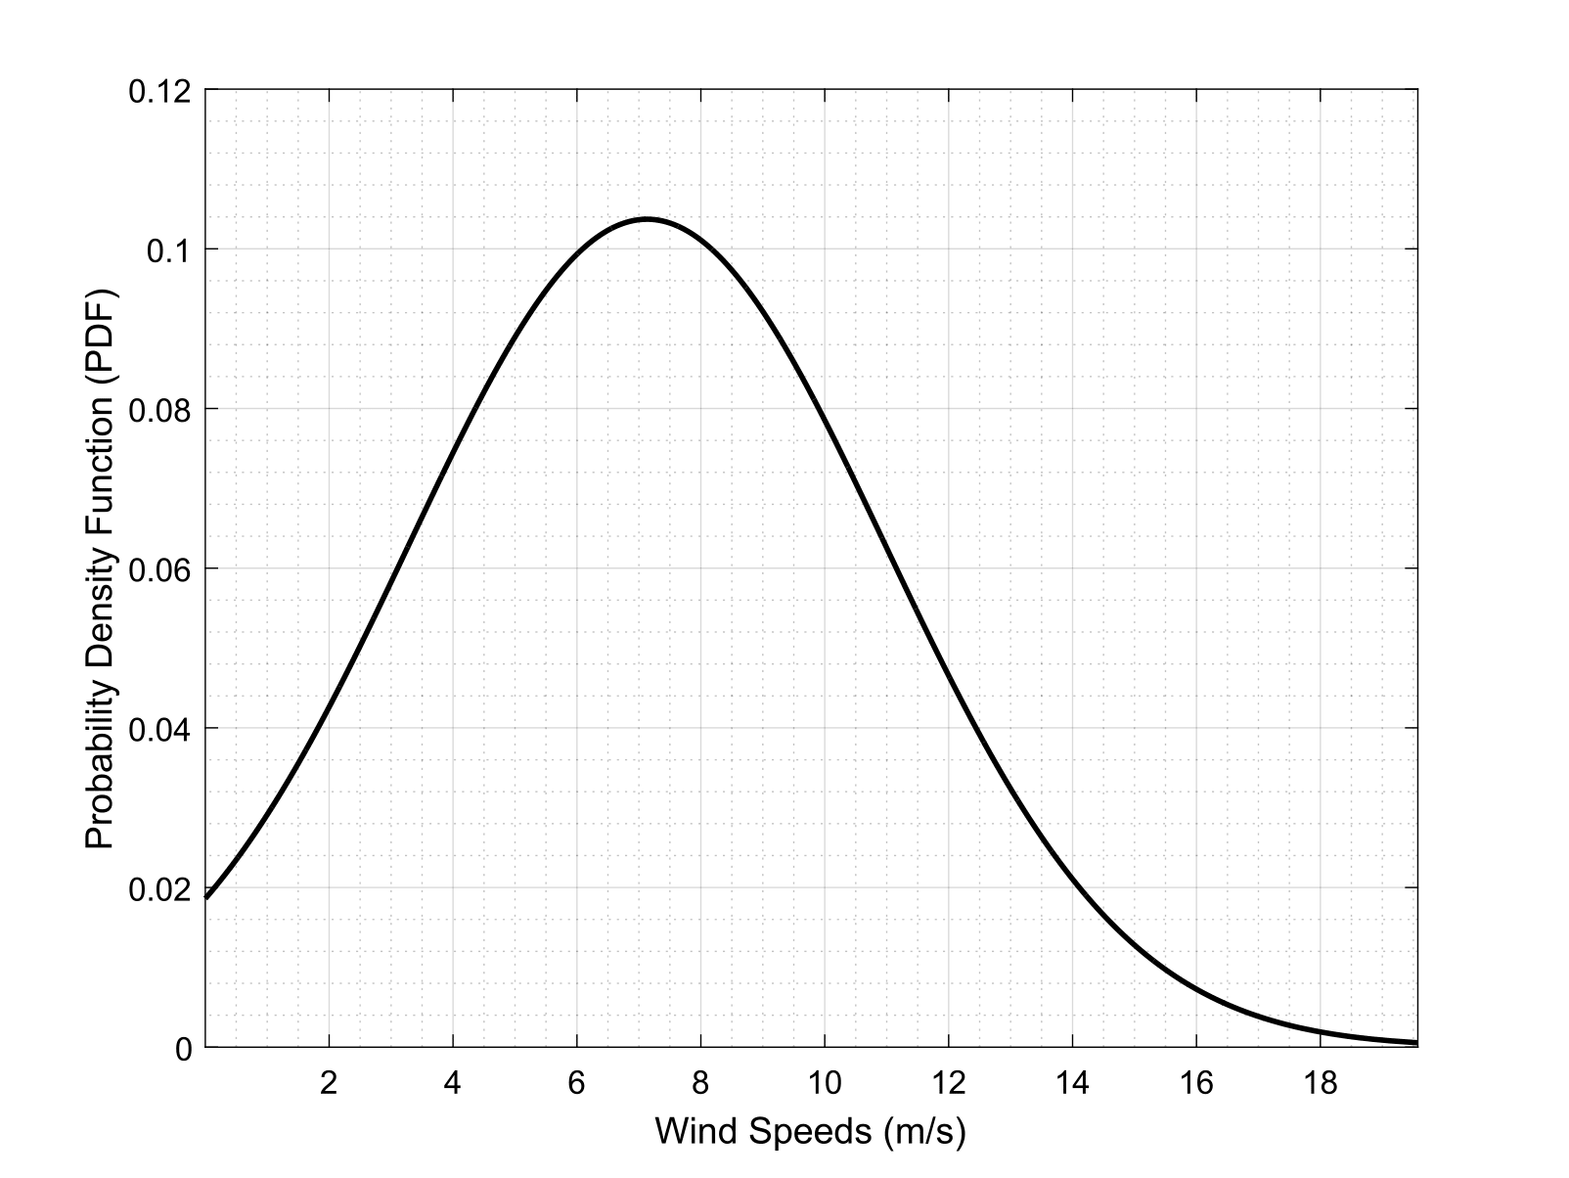
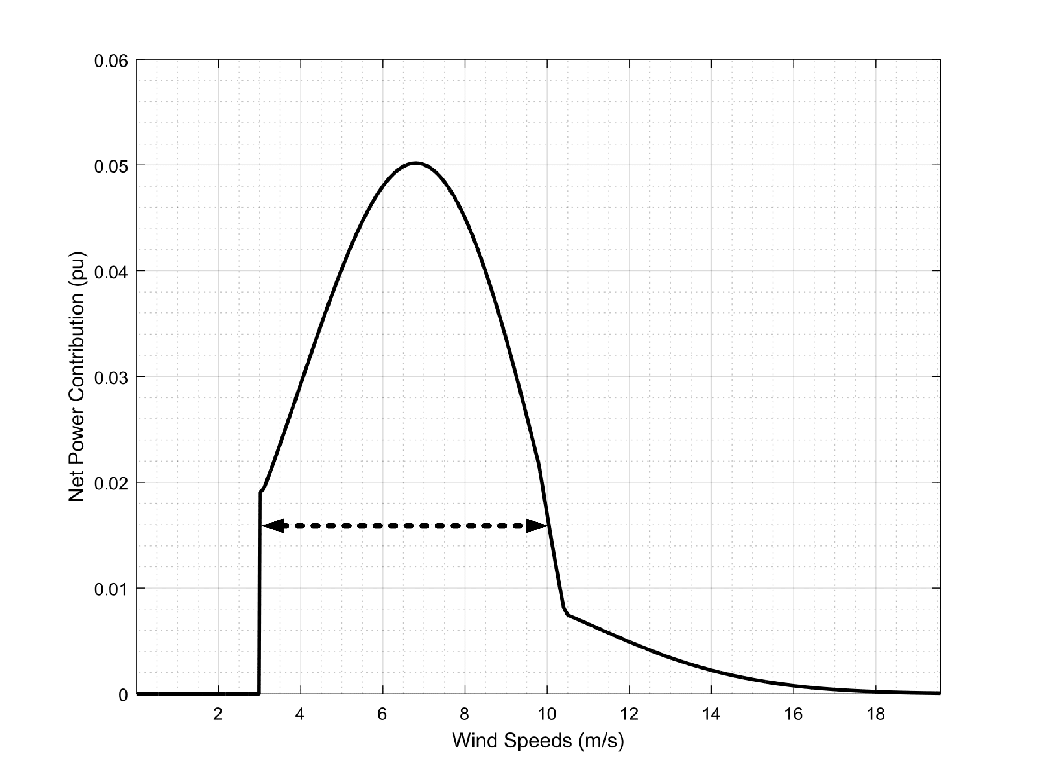
Fast Inertia Support
Figure 13: Probability Density Function of the Wind Speed Measurements
(01/01/2017-21/08/2017)
Figure 14: Net Power Contribution of the Different Wind Speeds
Notes:
Wind speed measurements used in this thesis are taken from a real wind farm with GE 2.75-103 model wind turbines between 01/01/2017 and 21/08/2017.
Main contribution of the wind turbine is in between the wind speed range of 3-10m/s.

Slide 17
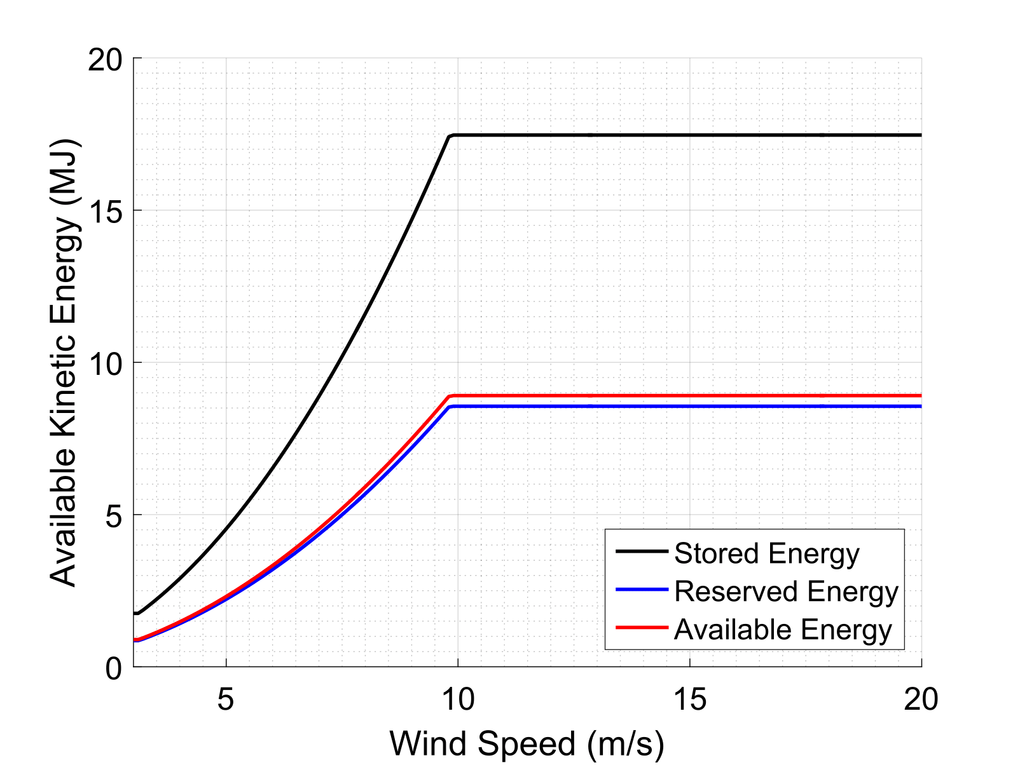
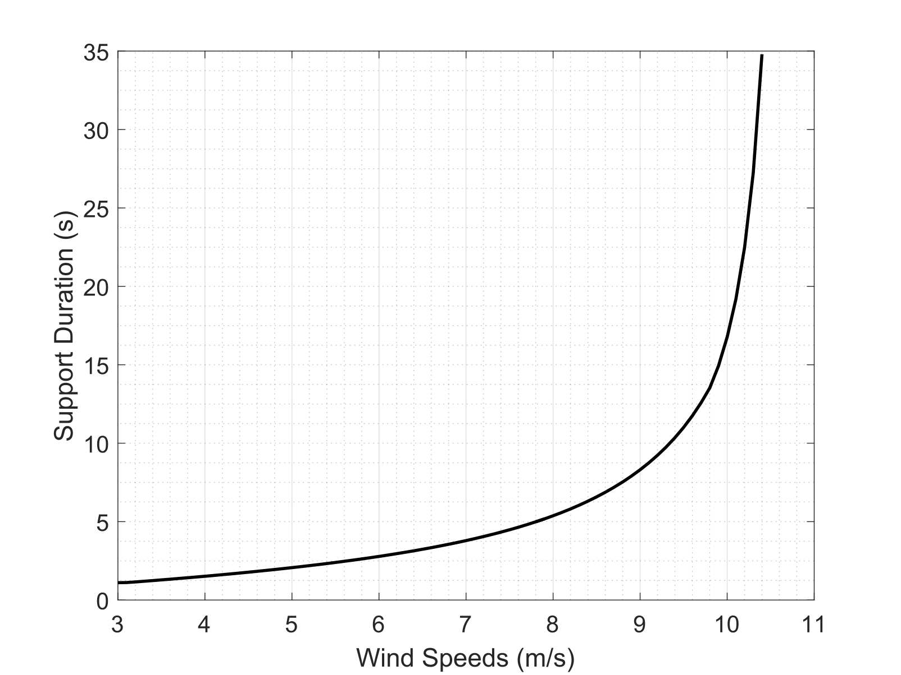
Fast Inertial Support
Figure 15: Available Kinetic Energy for Inertial Support
Figure 16: Support Durations on the Limit Case
Notes:
By combining the converter rating and available kinetic energy, it is possible to find the maximum support times for inertia support in the limit case.

Slide 18
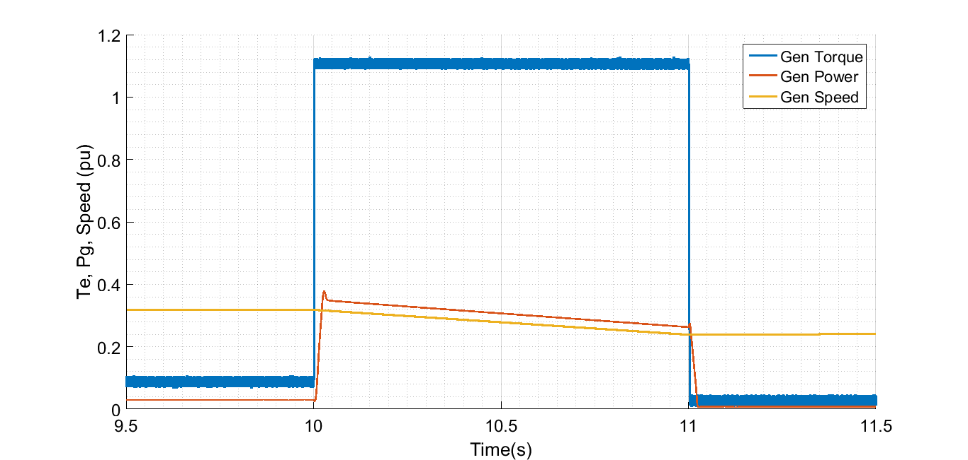
Fast Inertial Support
Figure 19: Limit Case Generator Torque, Power and Speed
for Low Wind Speed (3.12m/s)
Notes:
Low wind scenario. Generator 25%
Power increases up to 0.35pu.

Slide 19
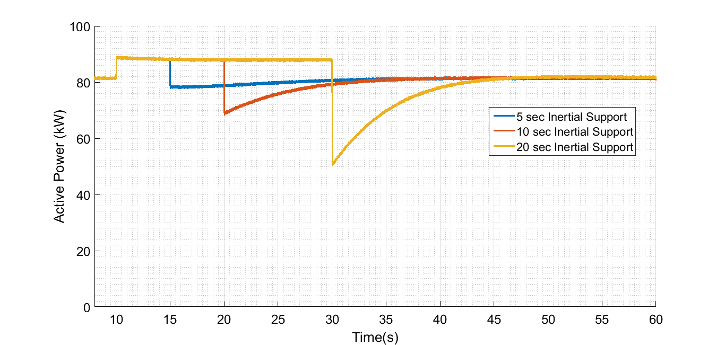
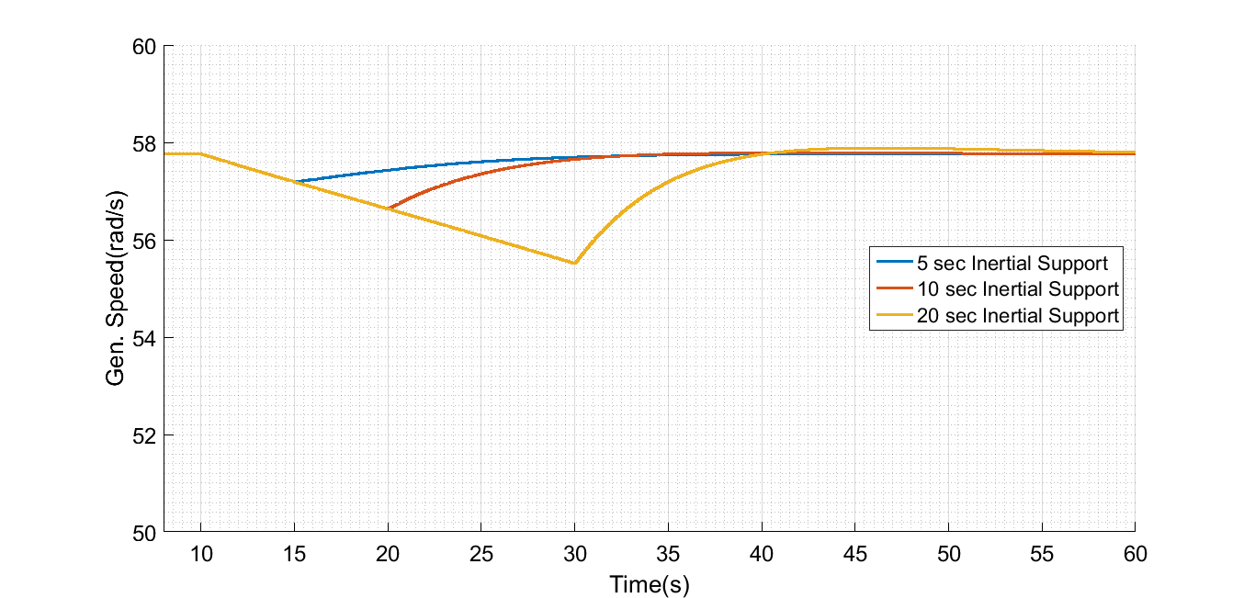
Fast Inertial Support
Active power is increased by 10% for 5s, 10s and 20s.
Power decreases higher for return process.
Speed Recovery is completed 10s.
Figure 20: Active Power and Generator Speed for Different Support Time Durations in Low Wind (3.12m/s)
Notes:
Low wind scenario.

Slide 20
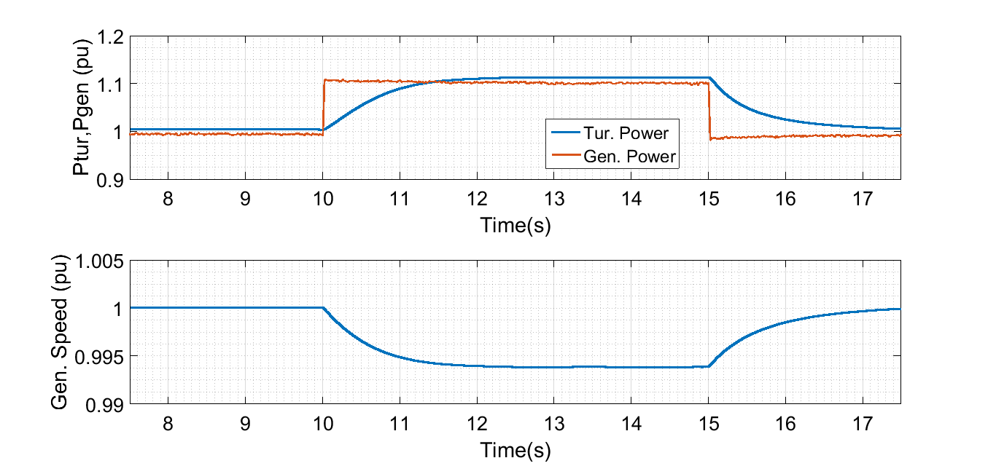
Fast Inertial Support
Figure 17: Limit Case Turbine Power, Generator Power and Speed
in High Wind Speed (11.4 m/s)
Notes:
High Wind Scenario is a bit different from other cases, since the turbine operates already in the rated power. Blade angle is different than zero. Therefore, power is curtailed for this operation. However, as the support is provided, the speed decreases below the maximum available speed. Therefore, the turbine torqu also increases in this case.

Slide 21
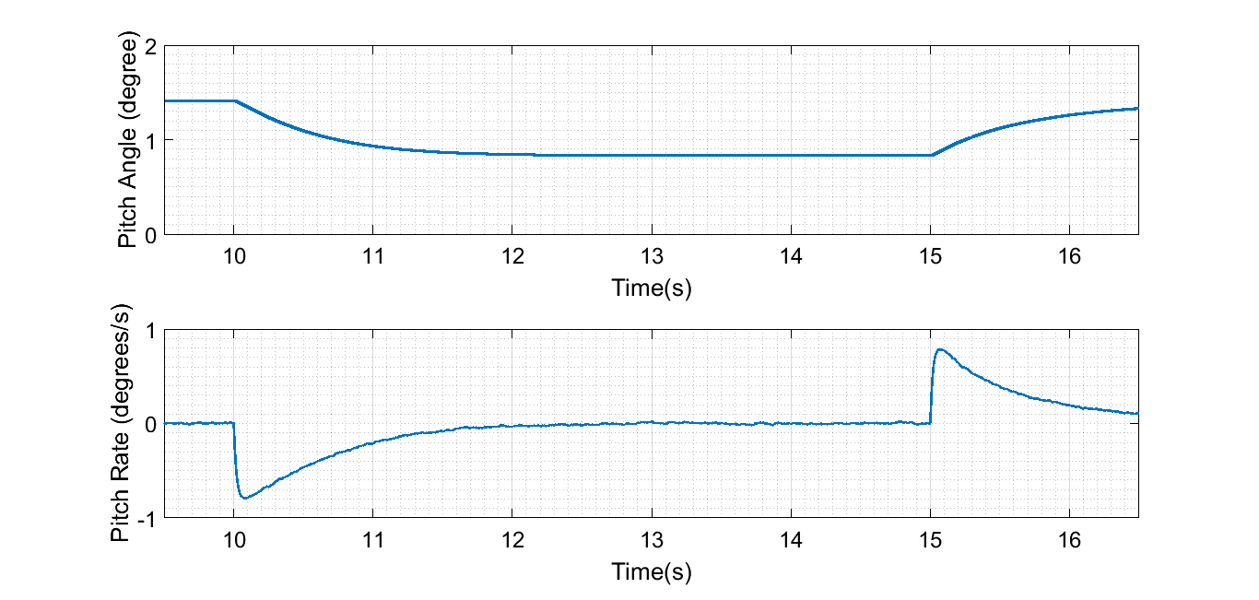
Fast Inertial Support
Figure 18: Limit Case Pitch Angle and Pitch Rate
in High Wind Speed (11.4 m/s)
Notes:
High Wind Scenario.
Maximum allowed pitch rate is 10degrees/s.

Slide 22
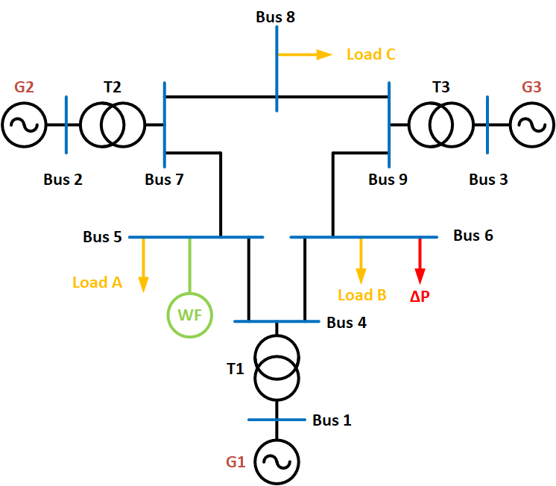
Implementation on a Test Case
Cases:
Base Case
10% Renewable Generation Case
Reduced Inertia Case
Figure 20: P.M.Anderson Test Case [6]
Notes:
The second type of inertial support is the synthetic inertia. To test the synthetic inertia concept, we need a frequency disturbance. Therefpre, IEEE test case is constructed in the system. Three cases are under consideration for the test case.

Slide 23
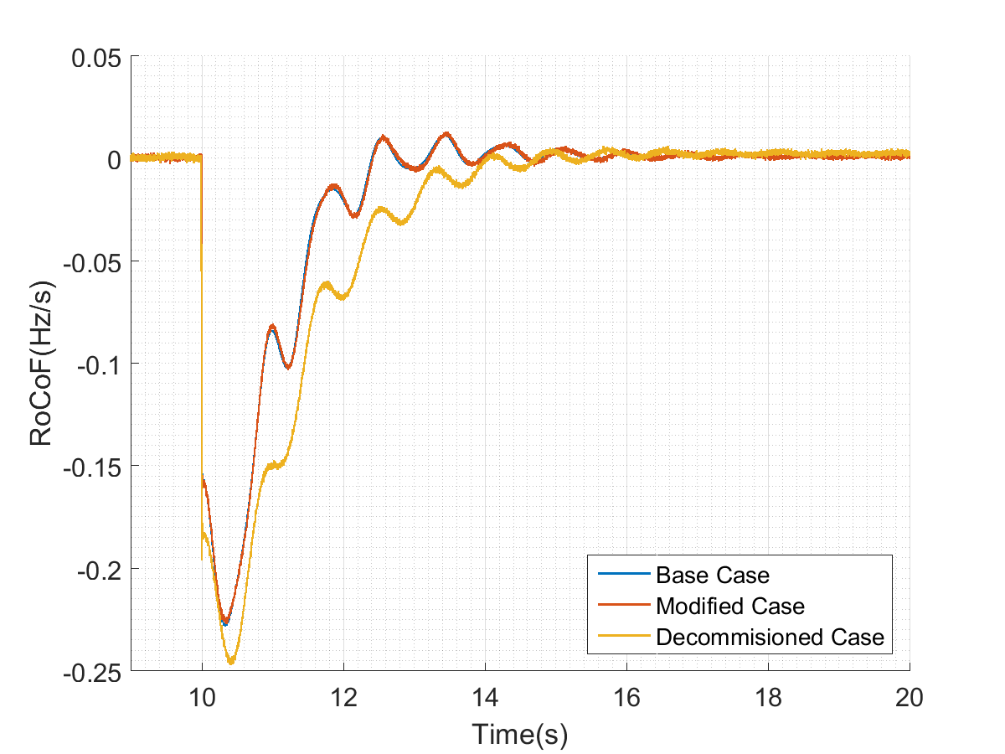
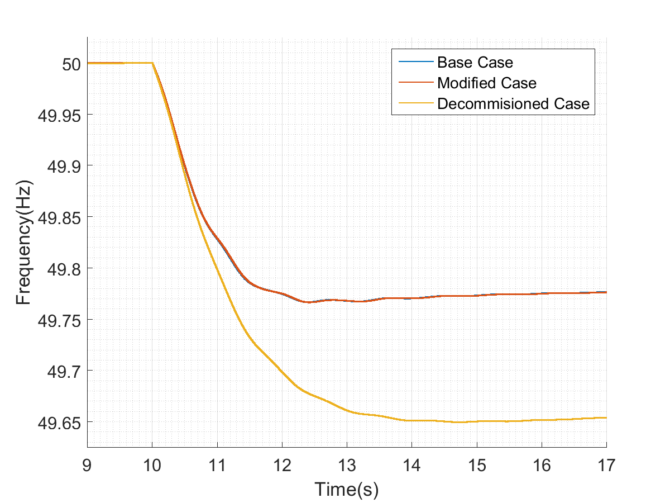
Implementation on a Test Case
Figure 21: Frequency and RoCoF for Base Case, 10% Renewable Case and Reduced Inertia Case

Slide 24
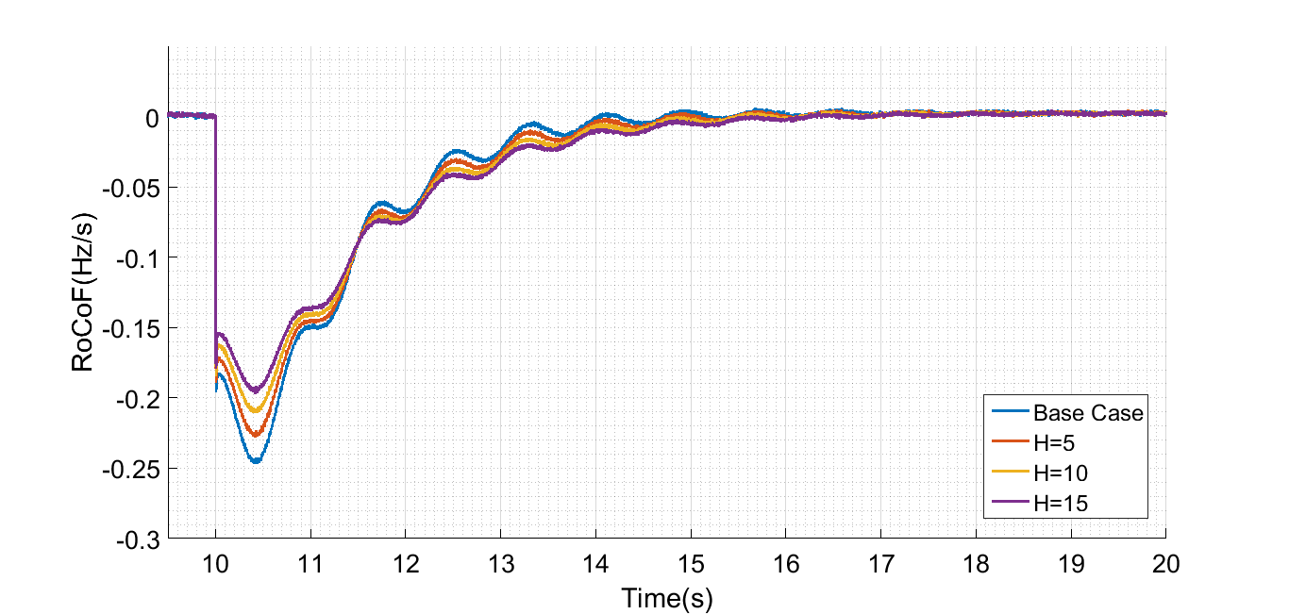
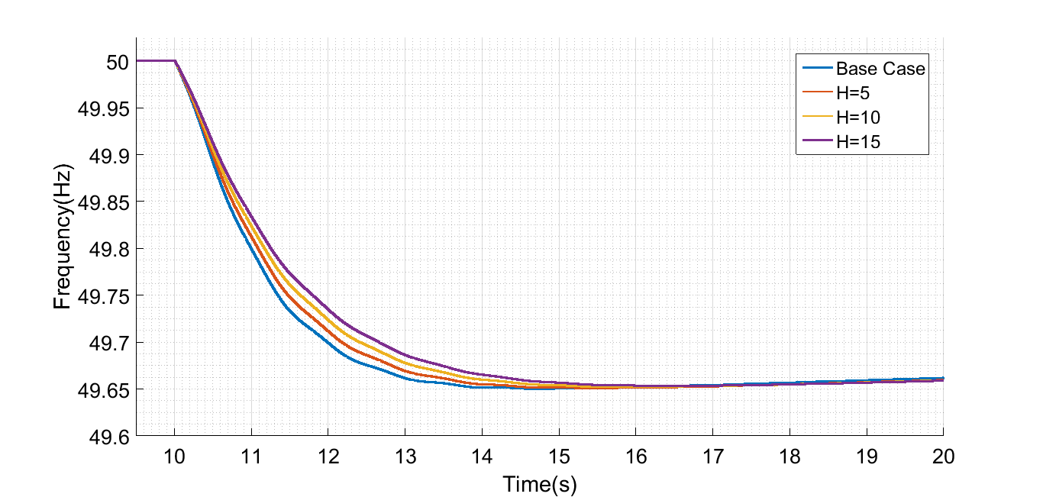
Implementation on a Test Case
Reduced Case Response is improved with synthetic inertia implementation.
RoCoF is improved by 16% when the H=10s is used.
Figure 22: RoCoF and Frequency for the Reduced Case with Synthetic Inertia Implementation

Slide 25
Implementation on a Test Case
 | Without Synthetic Inertia Impelementation |  |  | With Synthetic Inertia (H=10s)
 | Base Case | 10% Renewable Case | Reduced Inertia Case | 10% Renewable Case | Reduced Inertia Case
Stored Energy (GJ) | 3.3 | 3.6 | 3.3 | 3.6 | 3.3
Effective Stored Energy (GJ) | 3.3 | 3.3 | 3 | 3.9 | 3.6
Maximum RoCoF (Hz/s) | 0.23 | 0.23 | 0.25 | 0.19 | 0.21
Frequency Nadir (Hz) | 49.77 | 49.77 | 49.65 | 49.77 | 49.65
Figure 23: Effect of the Synthetic Inertia in System Frequency Response Parameters

Slide 26
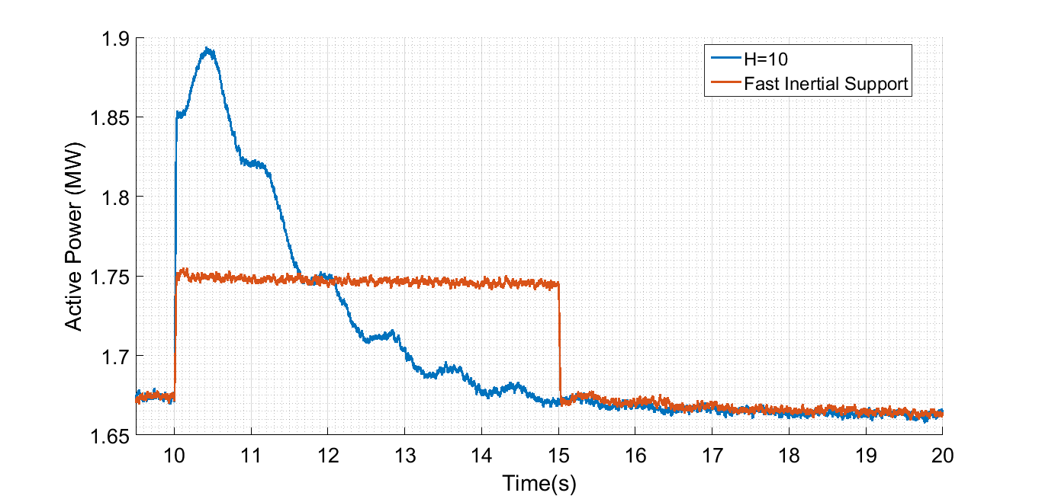
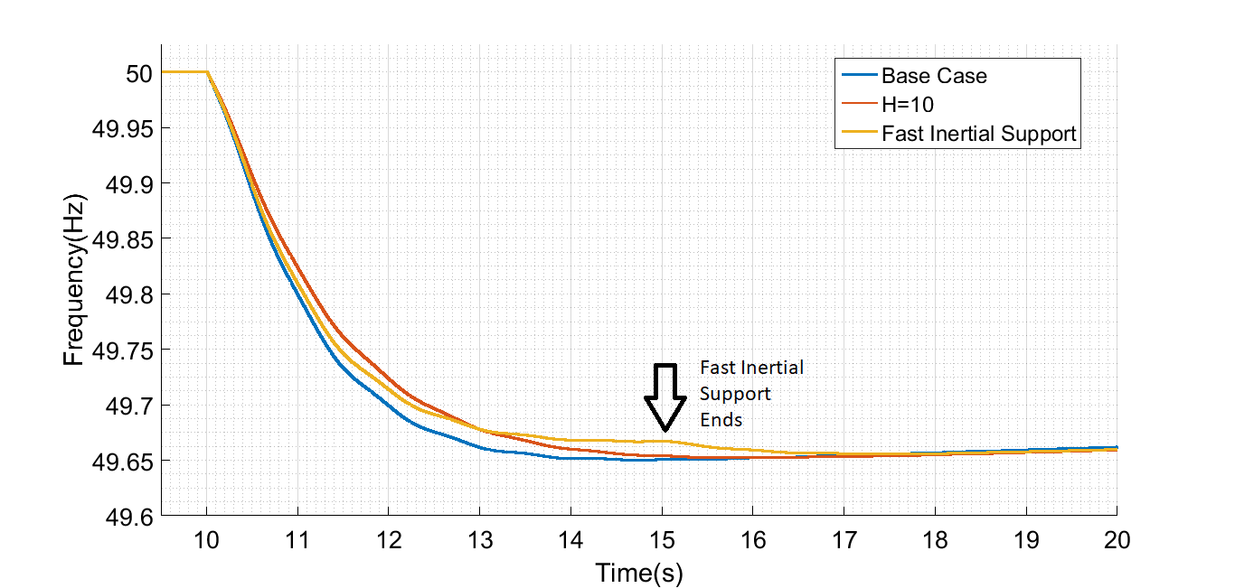
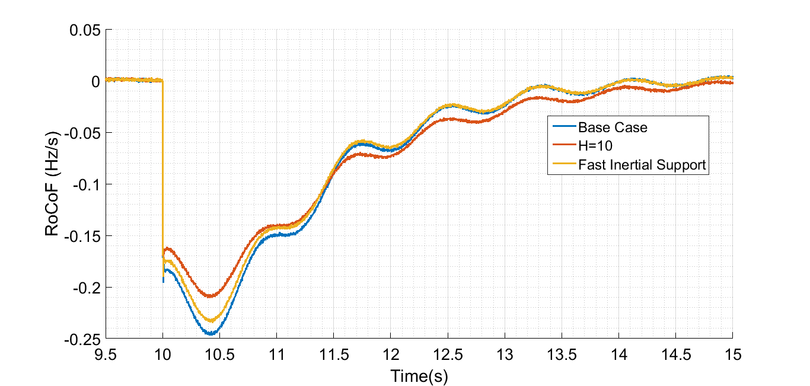
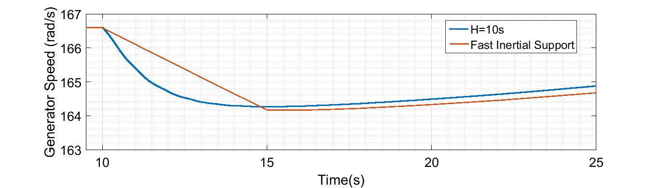
Comparison between Fast Inertial Support and Synthetic Inertia
Figure 24: Comparison between Fast Inertial Support and Synthetic Inertia based on the 400kJ Energy Extraction

Slide 27
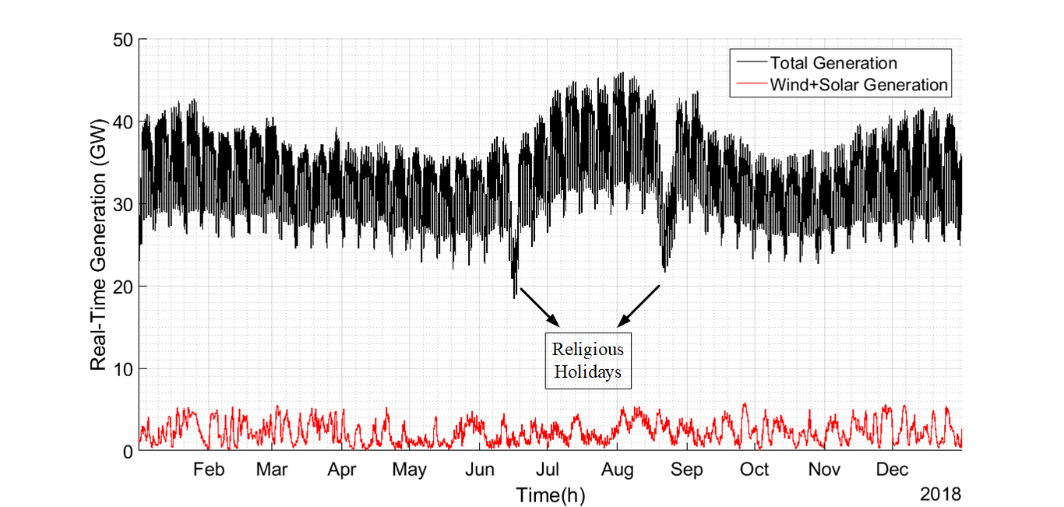
Effects on the Turkish Electricity Network
Figure 25: Variation of the Total Power and Wind+Solar Power in 2018 [7]
Notes:
In order to investigate the effect of the synthetic inertia implementation, the 2018 generation data has been used. In the figure, black line shows the variation of the generation meanwhile the red line shows the generation of wind + solar energy. The maximum generation occured in the 3th of August with a generation of 46GW. The minimum of the load has occured in a religious holiday on the 16th of July with a generation of 18GW.
The generation data can be used to roughly estimate the aggregated inertia constant in the grid.
As stated before, the effective inertia contribution from wind and solar systems are zero. Moreover, the inertia constants of the synchronous generators vary between 2-9. By using zero inertia constant for wind and solar, H=5s for others, the effective inertia constant can be calculated.s

Slide 28
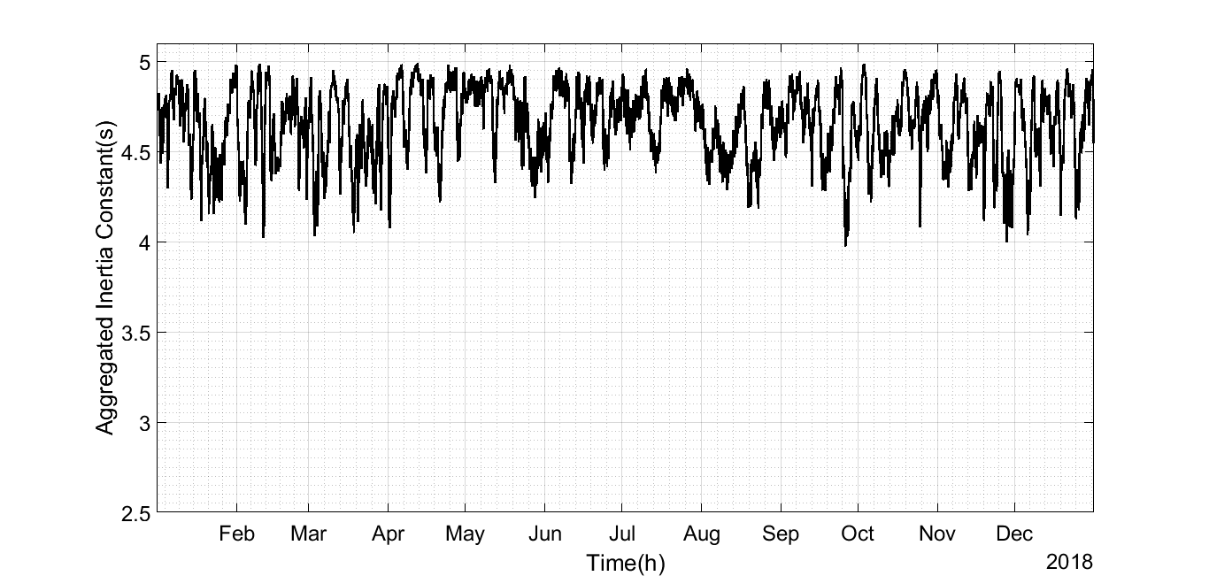
Effects on the Turkish Electricity Network
Figure 26: Variation of Aggregated Inertia Constant
(based on H=0 for Wind and Solar, H=5s for others)
Notes:
The effective aggregated inertia in the system is shown in the graph. Notice that the inertia constant decreases down to 3.97s when the 20% of the generation is supplied from wind and solar in 26/09/2019 on 3 pm.
It is possible to improve the effective inertia constant of the grid with synthetic inertia implementation. Note that the 54% of the installed wind energy systems in Turkey has FSPC. By assuming that 54% of wind energy production is obtained from these wind turbines and implementin inertia constant of h=10s, the improvement can be calculated.
When the method is implemented on the wind turbines with FSPCs,

Slide 29
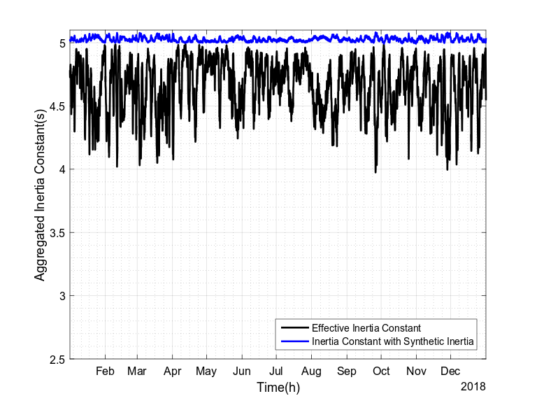
Effects on the Turkish Electricity Network
Date | 26/09/2018
Hour | 03:00:00
Total Generation (MW) | 27495
Wind (FSPC) (MW) | 3045
Wind (Other) (MW) | 2594
Solar (MW) | 0
Other (MW) | 21773
Existing Case | H=3.97s
With Synthetic Inertia (H=10) | H=5.08s
Figure 26: Variation of Aggregated Inertia Constant
(based on H=10s for Wind Turbines with FSPC)
Notes:
The existing inertia constant and inertia constant with synthetic inertia is shown in the figure. Notice that the inertia constant is above the H=5s. That means the wind turbines can compensate the decrease in the inertia constant caused by them and also caused by solar energy. Note that the inertia constant is maximum where the existings case inertia constant is minimum.

Slide 30
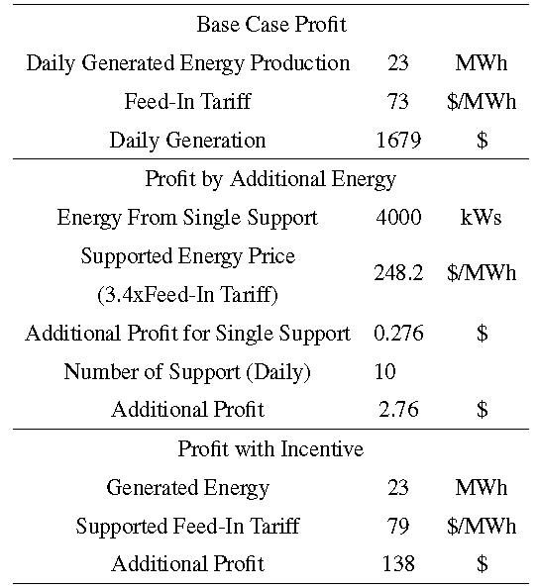
Economical Perspective
With additional energy or with additional incentives?
Profit by Additional Energy:
+0.16%
Profit by Incentive (0.6¢/kWh):
+8.2%
Figure 27: Economical Perspective of Synthetic Inertia
Notes:
How the inertia support should be paid to energy provider?

Slide 31
Economical Perspective
Net additional energy is zero! (There exists losses due to deviation from MPPT, inside the gearbox, converter etc.)
Let us only pay for the increased period (neglect the decrease):
A single support profit: $0.276 vs Daily Generation=$1679
Not possible with additional energy!
Incentives might convince the energy provider since it creates a significant rise on the profit (8.2% increase with 0.3¢/kWh).
Incentives will end at the end of 2020 for the new generation renewable energy systems. A new incentive might be inertial support from renewable energy systems!

Slide 32
Conclusions
Renewable energy systems should possess the inertial support capability to avoid the reduction in the grid inertia.
Inertial support capability of wind turbines with FSPC is limited with 10% in high wind speeds. Maximum increase occurs in 6.5m/s with 48% increase. Average contribution is 30%.
Wind turbine can emulate the inertia constant H=10s for the whole speed range.
Grid stored kinetic energy can be improved by 8% with the synthetic inertia implementation.
Energy providers cannot be convinced with solutions based on the additional payments but methods based on additional incentives.

Slide 33
References
[1] TEİAŞ, “Türkiye Kurulu Gücünün Birincil Enerji Kaynaklarına Göre Yıllar İtibariyle Gelişimi (2006-2016),” https://www.teias.gov.tr/. [Online]. Available: https://www.teias.gov.tr/tr/i-kurulu-guc. [Accessed: 07-Jan-2019].
[2] J. Eto, J. Undrill, P. Mackin, R. Daschmans, B. Williams, B. Haney, R. Hunt, J. Ellis, H. Illian, C. Martinez, M. OMalley, K. Coughlin, and K. Hamachi- LaCommare, “Use of Frequency Response Metrics to Assess the Planning and Operating Requirements for Reliable Integration of Variable Renewable Generation,” no. December 2010, pp. LBNL– 142E, 2010.
[3] E. Muljadi, V. Gevorgian, and M. Singh, “Understanding Inertial and Frequency Response of Wind Power Plants Preprint,” 2012 IEEE Power Electronics and Machines in Wind Applications (PEMWA), no. July, pp. 1–8, 2012.

Slide 34
References (cont’d)
[4] J. Licari, J. Ekanayake, and I. Moore, “Inertia response from full- power converter-based permanent magnet wind generators,” J. Mod. Power Syst. Clean Energy, vol. 1, no. 1, pp. 26–33, 2013.
[5] A. D. Hansen, M. Altin, I. D. Margaris, F. Iov, and G. C. Tarnowski, “Analysis of the short-term overproduction capability of variable speed wind turbines,” Renewable Energy, vol. 68, pp. 326–336, 2014.
[6] P. M. Anderson and A. A. Fouad, Power System Control and Stability. 2 ed., 2003.
[7] TEİAŞ, “Gerçekleşen Üretim,” EPİAŞ ŞEFFAFLIK PLATFORMU. [Online]. Available: https://seffaflik.epias.com.tr/transparency/. [Accessed: 07-Jan-2019].

Slide 35
Thank you!
Any questions?

Slide 36
Frequency Disturbance from Northern Cyprus

Slide 37
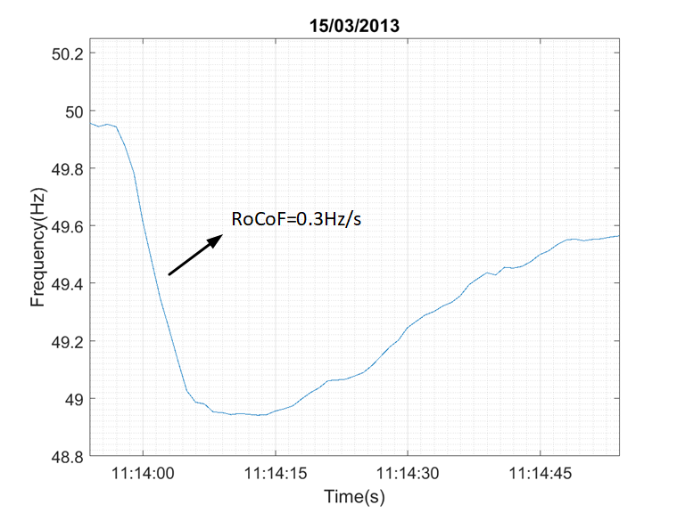
Frequency Disturbance

Slide 38
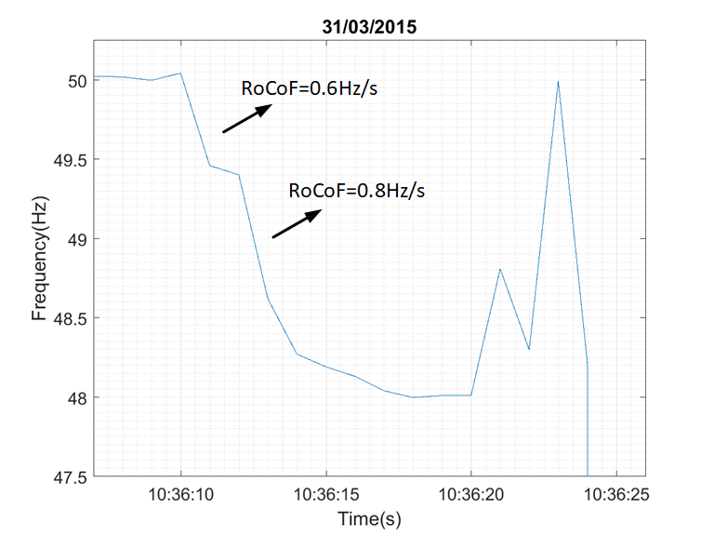
Frequency Disturbance

Slide 39
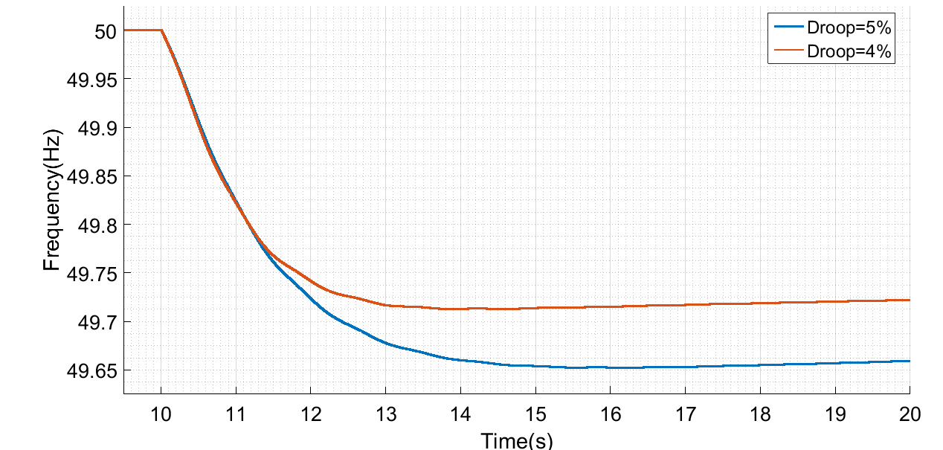
Frequency Disturbance with Droop=4%

Slide 40
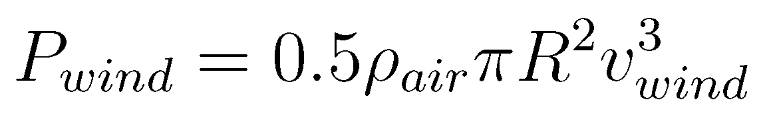
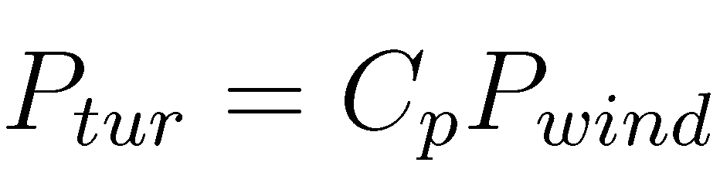
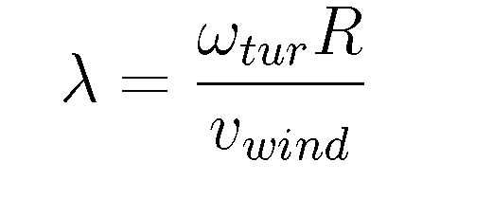
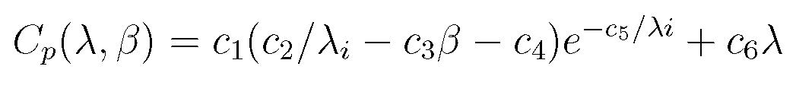

Aerodynamic Power
c₁=0.5176,c₂=116,c₃=0.4,c₄=5,c5=21,c₆=0.0068

Slide 41

Pitch Control
Pitch Rate is limited with 10°/s.
Maximum Pitch Rate is 0.8°/s in the system.

Slide 42


Vector Control of PMSG

